Slide 1
CONFLICT & STRESS
Cdr Vijay Pratap Singh
Adjunct Professor, E&TC

Slide 2
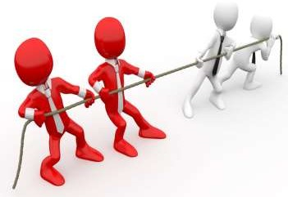
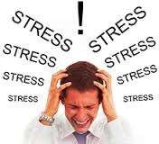
Context
Concept Of Conflict
Types of conflict
Role of conflict
Stress
Causes of stress
Effects of stress

Slide 3

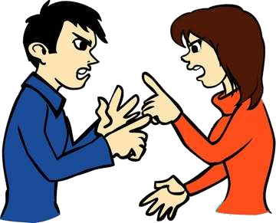
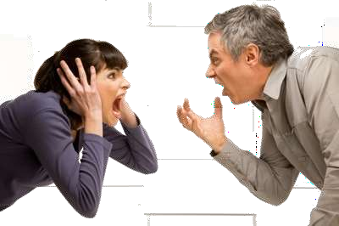
Concept Of Conflict
Conflict can be defined in many ways and can be considered as an expression of hostility, negative attitude, aggression, rivalry & misunderstanding.
It can be defined as a disagreement between two or more individuals or groups, with each individual or group trying to gain acceptance of its view or objectives over others.

Slide 4


Types of conflicts
1. Interpersonal conflict: It refers to a conflict between two individuals. This occurs typically due to how people are different from one another. We have varied personalities which usually results to incompatible choices and opinions.
2. Intrapersonal conflict: It occurs within an individual. The experience takes place in the person’s mind. Hence, it is a type of conflict that is psychological involving the individual’s thoughts, values, principles and emotions.

Slide 5


Types of conflicts
Intragroup conflict: It is a type of conflict that happens among individuals within a team. The incompatibilities and misunderstandings among these individuals lead to an intragroup conflict
Intergroup conflict: It takes place when a misunderstanding arises among different teams within an organization. For instance, the sales department of an organization can come in conflict with the customer support department.

Slide 6
Role of conflict
Change
Conflict accelerates change in an organization, especially in small businesses, where it is easy to formulate and implement new policies. Conflict prompts modification of policies and operation procedures in the organization.
Innovation
Conflict that results into healthy competition cultivates innovation and inventiveness amongst employees. In times of conflict, there is a high sense of necessity that results into the emergence of divergent viewpoints amongst employees.
Waste of Time and Resources
The business may lose precious time and resources at times of conflict. Instead of concentrating on meeting their objectives, employees waste time on divisive issues.

Slide 7
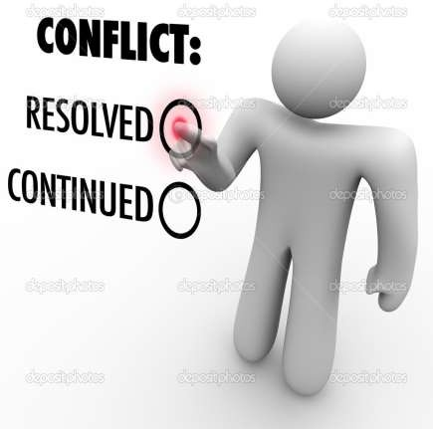
How to resolve conflict in an organisation
Positive Perspective
Grievance Procedure
Get To The Cause
Equal Voice

Slide 8
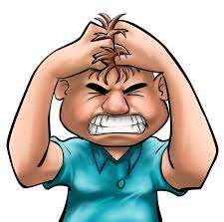
Stress
Stress is defined in terms of its physical and physiological effects on a person, and can be a mental, physical, or emotional strain.

Slide 9




















Stressors intrinsic to the job
Role ambiguity
Role conflict
Causes of Stress
Organisational Cause
Role overload
Role under load
Responsibility of people
Lack of participation Job concern
Personal Cause
Relocation
Change in life structure

Slide 10
Few more Causes of Stress
Unrealistic expectations
Setting Unrealistic goal
Poor planning
Financial insecurities
Habit to achieve perfection
Job insecurity
Unsupportive work culture
Nature of work load
Increased work load,
Challenges to meet deadlines and milestones
Pressure to perform
Lack of physical exercise and spiritual practices

Slide 11
How stress affects your thoughts and emotions
You might notice signs of stress in the way you think, act,
and feel. You may:
Feel cranky and unable to deal with even small problems.
Feel frustrated, lose your temper more often, and yell at others for no reason.
Feel jumpy or tired all the time.
Find it hard to focus on tasks.
Worry too much about small things.
Feel that you are missing out on things because you can't act
quickly.
Imagine that bad things are happening or about to happen.

Slide 12
How to Cope Up With Stress
Get Moving and involve in positive thoughts
Practice laughter, Yoga & Exercise
Accept Certain things that you can’t change
Get time for mind relaxation, read books
Seek Doctor’s advise if stress beyond control
Cut off your mind from routine jobs
Challenge yourself
Take body massage at regular intervals.
Spend time with pets.
Undertake gardening.
Take a walk in greenery. Take healthy and balanced diet.
Do better time management by prioritising jobs.
Spend quality time with family and friends.

Slide 13
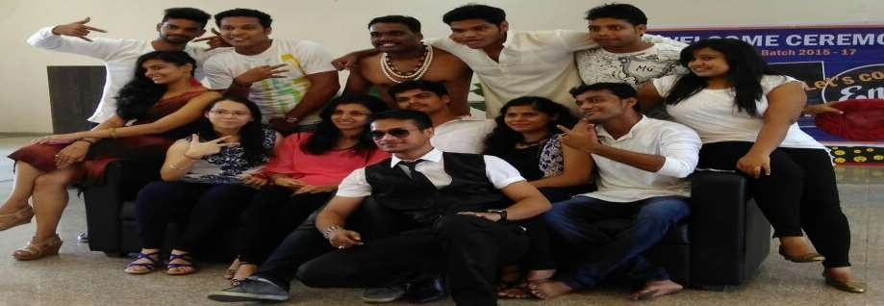
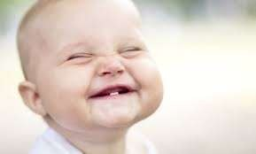
How to Cope Up With Stress
Reduce or give up alcohol, smoking, drugs etc if addicted.
Listen to music of your liking.
Don’t try to remember bad memories.
Avoid multitasking when passing through stress.
Do things in bits and peace.
Play with kids.
Go for run for 30 min (morning & evening) & Play sports.
Have adequate sleep.

Slide 14
The End

